Slide 1
Sales Forecasting
Team Member:- Supervisor:-
Sharad Gupta (Team Leader) Dr. Akash Rajak Sir
Yash Raj Singh

Slide 2
INTRODUCTION:-
In today’s highly competitive environment and ever-changing consumer landscape, accurate and timely forecasting of future revenue, also known as revenue forecasting, or sales forecasting.
Earlier , Companies were using traditional model for sales forecasting.
There are several ways of forecasting sales in which companies have previously focused on various statistical models such as time series and linear regression, feature engineering and random forest models to obtain future sales and demand prediction.

Slide 3
Libraries Used
Numpy :- Mathematical and logical operations are performed with the help of NumPy.
Pandas :- Pandas is a software library that is designed for manipulating the data and analysis in a python programming language.
Matplotlib :- Matplotlib is a module of Python used to plot the attractive Graphs.
SKlearn :- Scikit-learn is a free python library. It features multiple clustering classification and regression algorithms.
Seaborn :- Seaborn is a open-source python library that is used for statistical graphics.

Slide 4
Hardware Requirements
Hardware specifications required for installing all the required software environment and tools.
Processor – Intel i3 5th Generation or above
RAM – Minimum 4GB ,Recommended 8GB or above
Disk Space – Minimum 20 GB free of disk space

Slide 5
Software Requirements
Operating System - Windows 10/11 or any Linux OS
Code Editor – Jupyter Notebook

Slide 6
Benefits
Without sales, a company cannot grow. This is why every company has to consistently bring in new revenue.
Machine learning can significantly improve the speed of your sales team’s workflow, allowing them to focus on the most qualified opportunities.
Machine learning can help by providing new insights into customer behavior and patterns.
The ultimate goal of selling more is to do it more efficiently, without having to invest a lot of money into hiring more salespeople.

Slide 7
Results
Machine Learning algorithms such as Linear Regression, KNearest Neighbors algorithm, XGBoost algorithm and Random Forest algorithm have been used to predict the sales of various outlets of the Organization. Various parameters such as Root Mean Squared Error (RMSE), Variance Score, Training and Testing Accuracies which determine the precision of results are tabulated for each of the four algorithms.

Slide 8
Conclusion
With traditional methods not being of much help to the business organizations in revenue growth, use of Machine Learning approaches prove to be an important aspect for shaping business strategies keeping into consideration the purchase patterns of the consumers. Prediction of sales with respect to various factors including the sales of previous years helps businesses adopt suitable strategies for increasing sales and set their foot undaunted in the competitive world

Slide 9
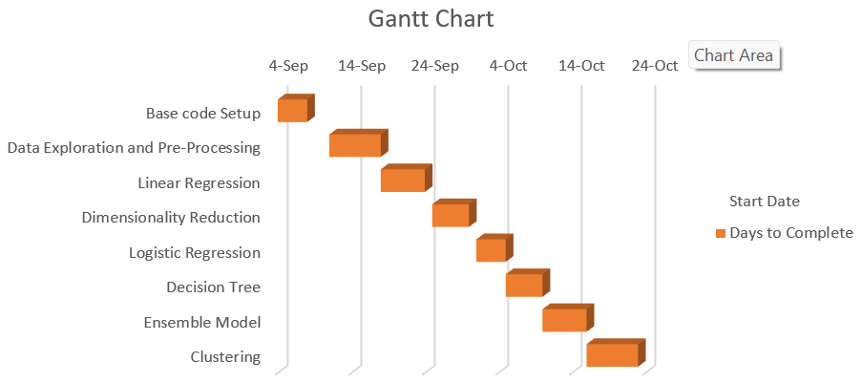
Gantt Chart

Slide 10
!!! THANK YOU !!!

